Slide 1

English
This presentation is automatically generated.
You can freely edit it and add any extra content you wish.
Español
Esta presentación se genera automáticamente.
Puedes modificarla a tu criterio y añadir cualquier contenido adicional que desees.
Italiano
Questa presentazione è generata automaticamente.
Puoi modificarla liberamente e aggiungere eventuali contenuti extra che desideri.

Slide 2
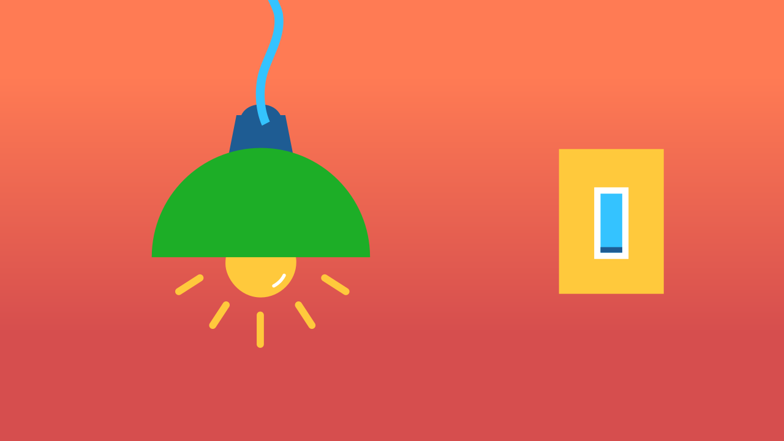
The Switch: On or Off?
Explore more advanced logic with 'If-Then-Else' conditionals to create a fully functional light switch.

Slide 3
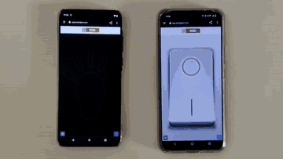
What will we do?

Slide 4
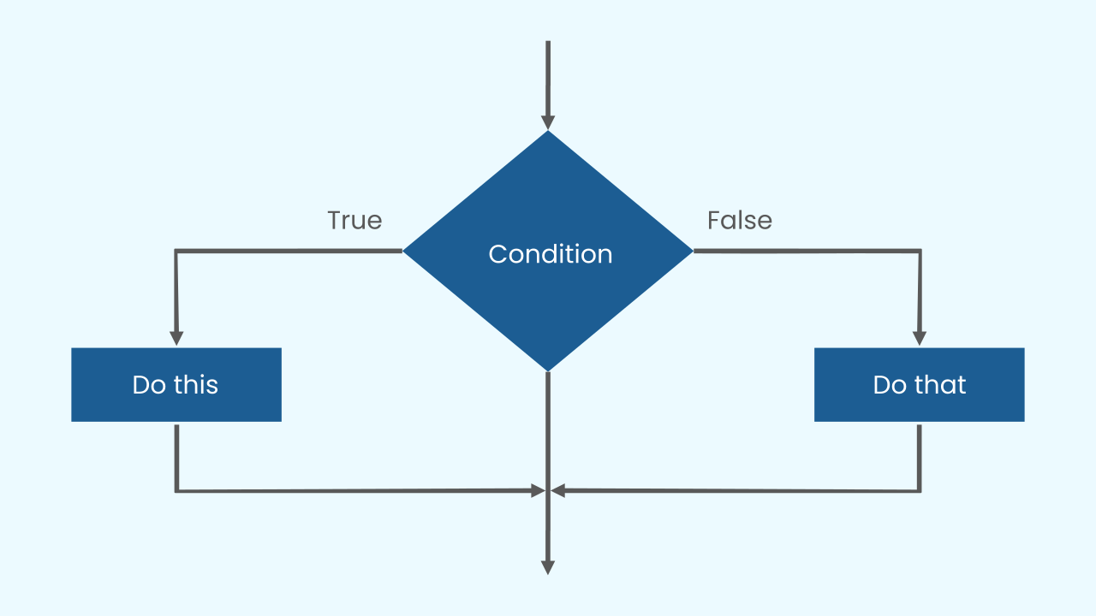
Leveling Up Our Logic
We've seen how a simple conditional works: IF a condition is true, THEN an action happens. But what if the condition is *false*? Usually, the program just does nothing.
To make our code smarter, we can add a second part: an ELSE.
The full structure, “if, then, else,” gives the computer a complete set of instructions: “if something is true, then do this; else (otherwise), do something completely different.”

Slide 5
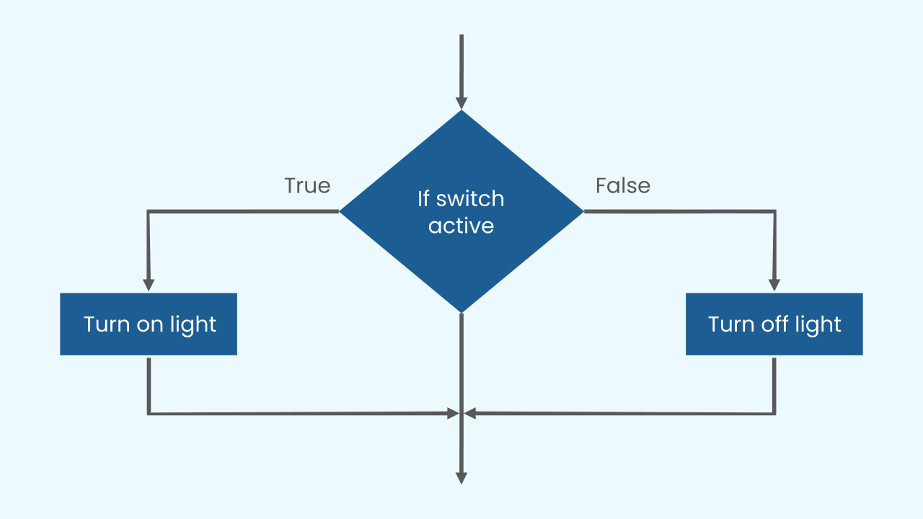
IF pressed, THEN on, ELSE off.
A light switch is a perfect example of this. The logic is simple: “if the switch is active, then turn on the light; else, turn off the light.”
This means that if the program detects that the switch is active, it will execute the action in the "then" (or "do") part. But if the switch is *not* active, it will execute the action in the "else" part instead.
And how do we make our program check the switch constantly? With the main loop, of course!

Slide 6
Make a Lamp with a Switch
Let’s create a prototype that lets us turn on a light by pressing a button.
Press Add Device and select Lamp.
Press Add Device again and select Switch.
Remember that if you don’t have smartphones to scan the QR codes, you can press Open in this window to open the components on the same computer.

Slide 7
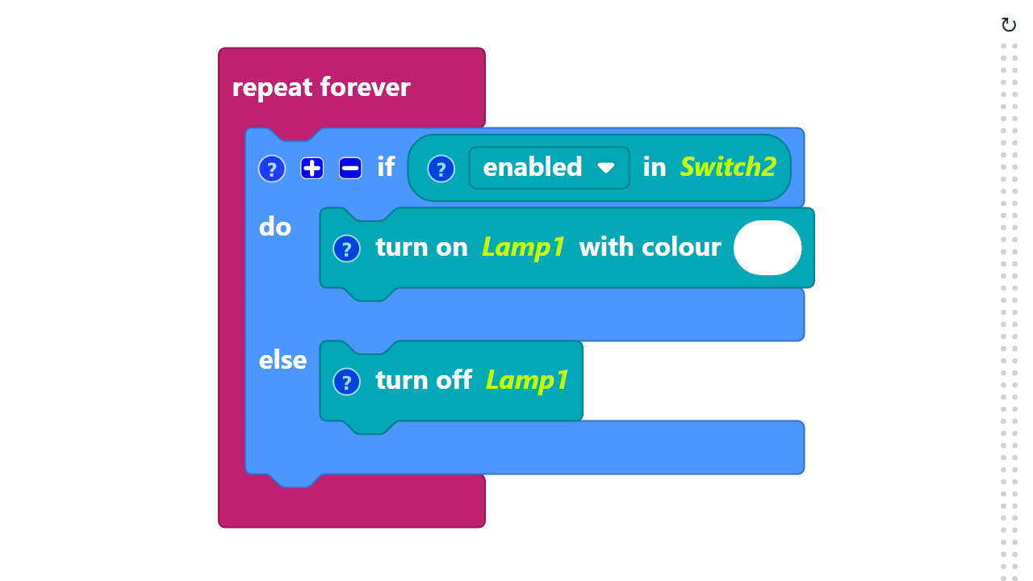
Code Composition
Click on the question mark icon to open the comments that explain the code.
https://app.protobject.com/generate?a09-lampswitch&en&dynamic&-1

Slide 8
Reflect
This 'IF/THEN/ELSE' logic is one of the most important concepts in all of programming.
*Think about your daily life or your favorite apps. Where do you see this kind of two-part choice being made? (e.g., IF a password is correct, THEN log in, ELSE show an error message).*

